Slide 1

Cryptocurrency Data Analysis
CS685A : DATA MINING
Project Report
Supervised by : Prof Dr. Arnab Bhattacharya

Slide 2
Contributors :
Group No. 21
Name | Roll number (Email-ID)
Abhishek Dnyaneshwar Revskar | 21111003 (abhishekdr21@iitk.ac.in)
Akash Gajanan Panzade | 21111006 (akashp21@iitk.ac.in)
Ashitosh Vankatrao More | 21111017 (ashitoshvm21@iitk.ac.in)
Mayuresh Diwakar Shandilya | 21111041 (mayuresh21@iitk.ac.in)
Prajwal Pradiprao Thakare | 21111047 (prajwalt21@iitk.ac.in)

Slide 3
Problem Statement
Since the cryptocurrency has drawn much attention, many people are interested in investing in this digital asset. But this market possesses potential risk for investors and to tackle this a proper analysis of historical data is required which is not yet done.
Our study will give a fair idea about the risk involved and the different options available for investment.
We have analyzed the top 100 cryptocurrencies circulating in the market in different aspects and compared them on the basis of various factors.

Slide 4
DATASETS USED
Cryptocurrencies Dataset : It contains day-by-day historical data of top 100 cryptocurrencies from ”https://coinmarketcap.com” where the duration of analysis is from 1st January 2015 or from the day of inception (whichever is earlier) till 11th November 2021.
Gold Dataset : This dataset contains day-by-day price of gold in US Dollars
S & P 500 Index Dataset : This dataset contains day-by-day opening and closing prices of S & P 500 Index which is an index of US Stock Market
Nifty50 Dataset : This dataset contains information about Indian Stock Exchange Indicator Nifty50.

Slide 5
Data Cleaning
In the data cleaning process, we have removed the ‘,’(comma) from the dataset wherever it was necessary .
We have also converted the $ notation into numerical representation.
We have converted the date into proper format.
We have sorted the dataset according to date from oldest to newest
The daily change in price is given in percentage and is converted into ratio

Slide 6
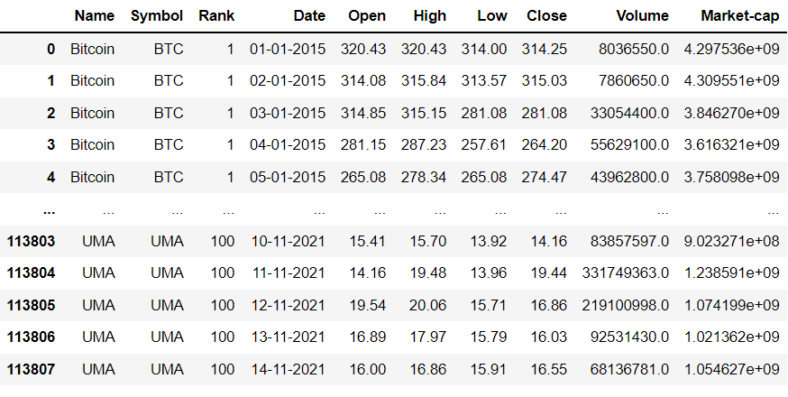
Cryptocurrency Dataset

Slide 7
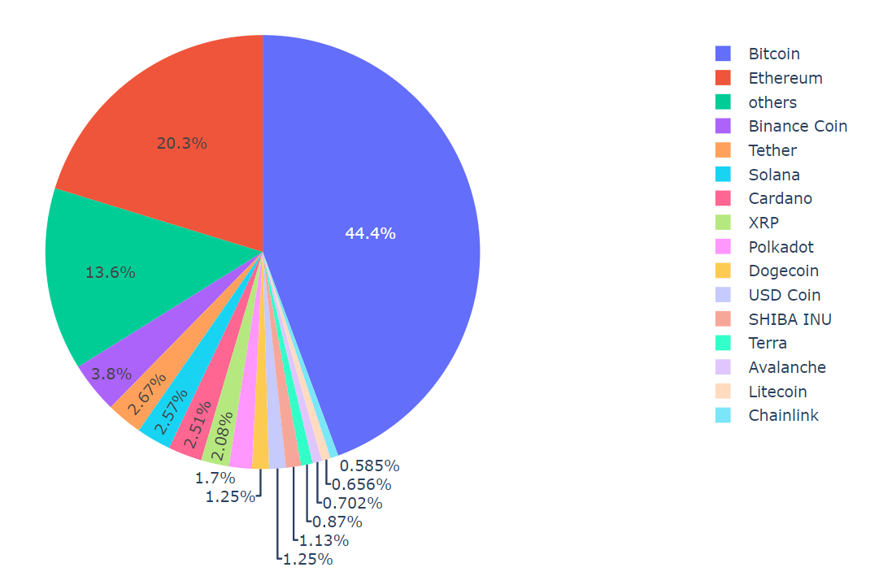
Data Analysis
We have analyzed various aspects of the cryptocurrency and framed some questions which are follows
Market Share according to Market Cap

Slide 8
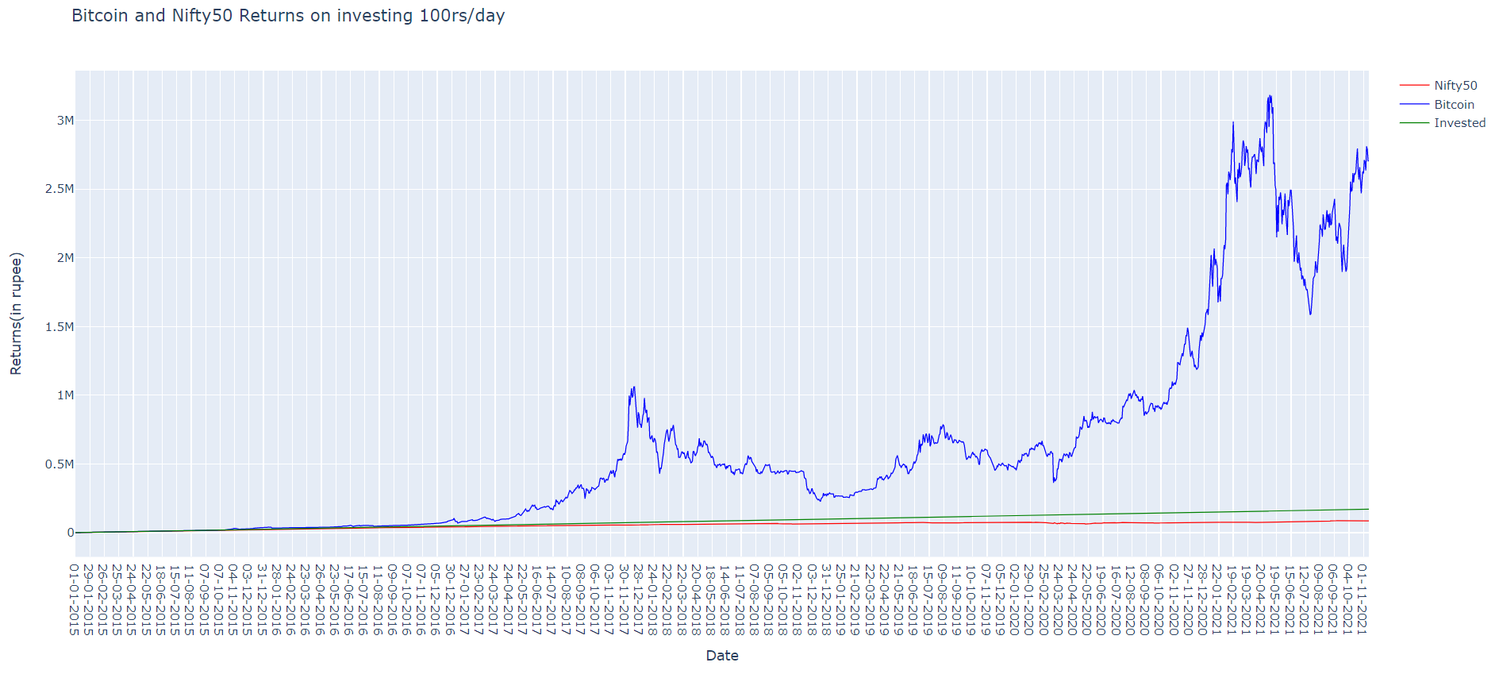
2. Comparing “Bitcoin” and “Nifty 50”

Slide 9
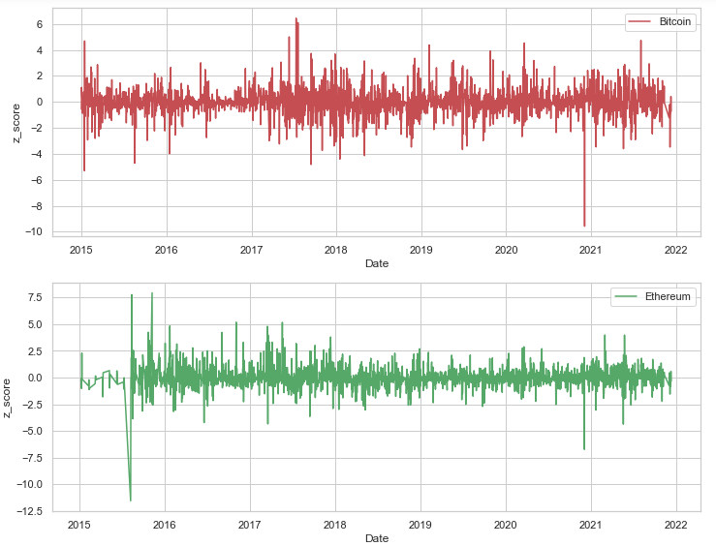
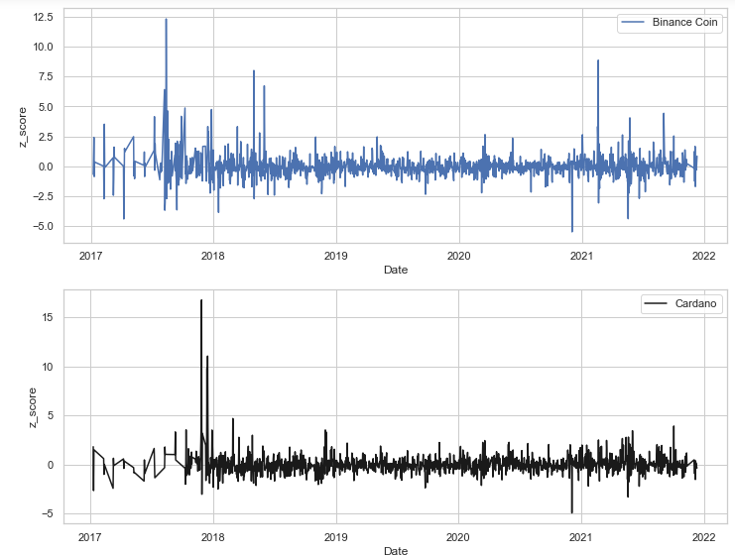
3. Risk Analysis of Top 4 Cryptocurrencies using Z-Score

Slide 10
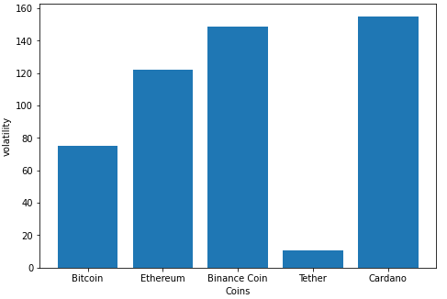
4. Comparing Volatility of Top 5 Cryptocurrencies

Slide 11
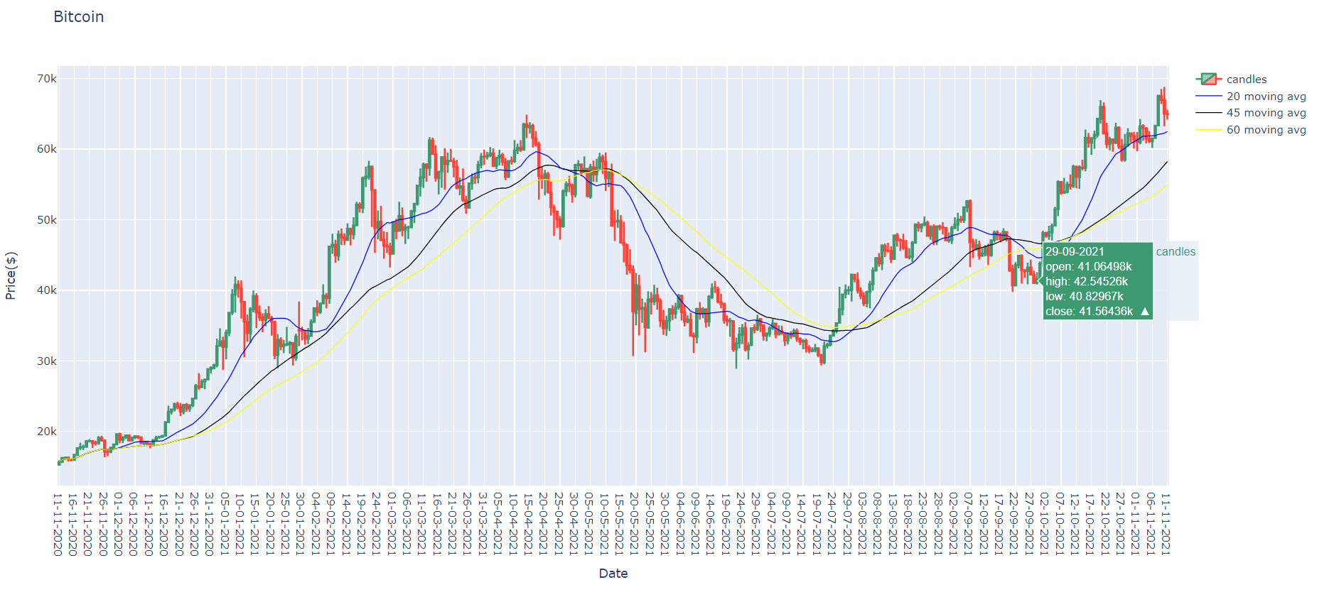
5.Candlestick chart and Moving Average for Bitcoin

Slide 12
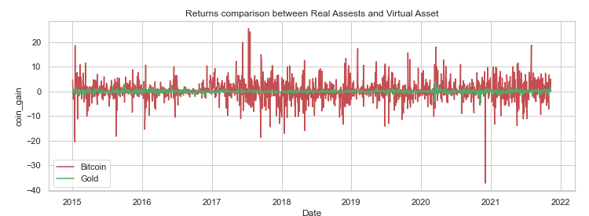
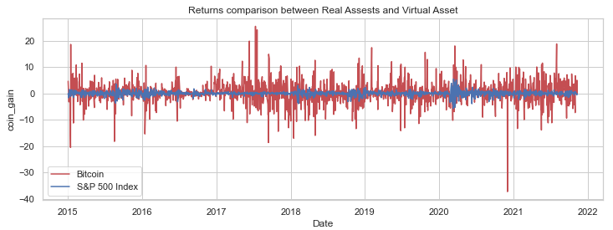
6. Comparing Virtual Asset with Real Assets

Slide 13
Conclusion
All the questions that we tried to answer in this project helps an investor to take a look at the risk involved and the returns he/she can expect from investing in different cryptocurrencies.
We have also compared this virtual asset with traditional investment options which helps to make a good tradeoff between the risk and the returns on the capital invested.
Each analysis helps in some or the other aspect before making the final investment decision.
We also compared the different cryptocurrencies so that one can diversify within this class of asset itself.
After considering all the analysis collectively, one can make a decision suitable to his risk appetite.

Slide 14
References
Day-by-day Historical Data of Top 100 Cryptocurrencies : https://coinmarketcap.com/ https://coinmarketcap.com/currencies/bitcoin/historical-data/
Day-by-day Historical Data of Nifty50 Index of Indian Stock Exchange (NSE): https://in.investing.com/indices/s-p-cnx-nifty-historical-data
Volatility Analysis : https://blog.quantinsti.com/
Candlestick chart analysis : https://en.wikipedia.org/wiki/Candlestick pattern
Moving Averages analysis : https://zerodha.com/varsity/chapter/movingaverages/

Slide 15


